Slide 1
Introduction to Koha

Slide 2
Introductions
Kathryn Tyree, Project Manager
@kathrynpipesup
Chris Cormack, Software Developer
@ranginui
Liz Rea, Open Source Software Analyst
@wizzyrea

Slide 3
Agenda
Health and safety
The Koha community: organisation and development
Koha integration and extension examples: demonstrating the freedom to select and display content however you wish
Q & A

Slide 4
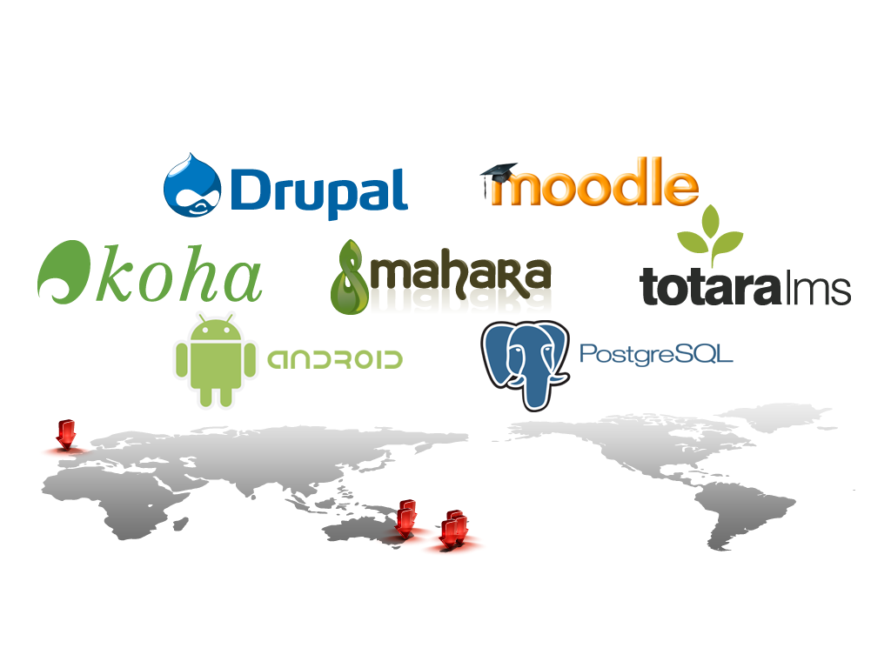

About Catalyst

Slide 5
Koha support
Koha can be hosted and supported by Catalyst, or on servers within your organisation with Catalyst support
Libraries only pay for the services and support they need
Catalyst stand behind Koha as a product, and guarantee our work.

Slide 6
The Koha community: Organisation and development

Slide 7
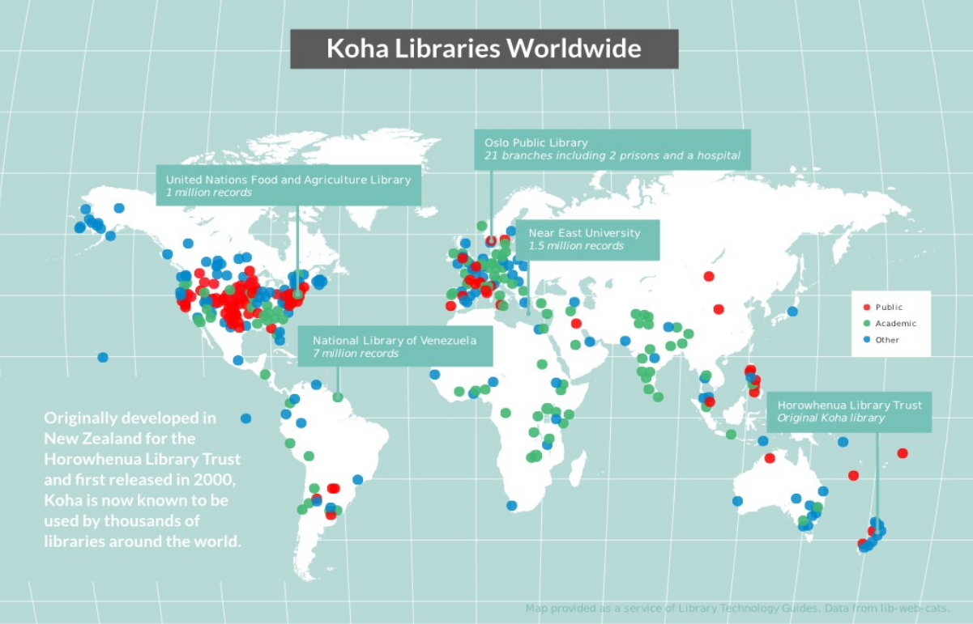

Slide 8
Koha is licensed under the GPL v3
“This program is free software: you can redistribute it and/or modify it under the terms of the GNU General Public License as published by the Free Software Foundation, either version 3 of the License, or (at your option) any later version”.
http://www.gnu.org/licenses/gpl-3.0.en.html

Slide 9
The four freedoms of free software
Freedom to use the software as you wish
Freedom to redistribute the software to to help others
Freedom to study and change the software as you wish
Freedom to distribute software changes

Slide 10
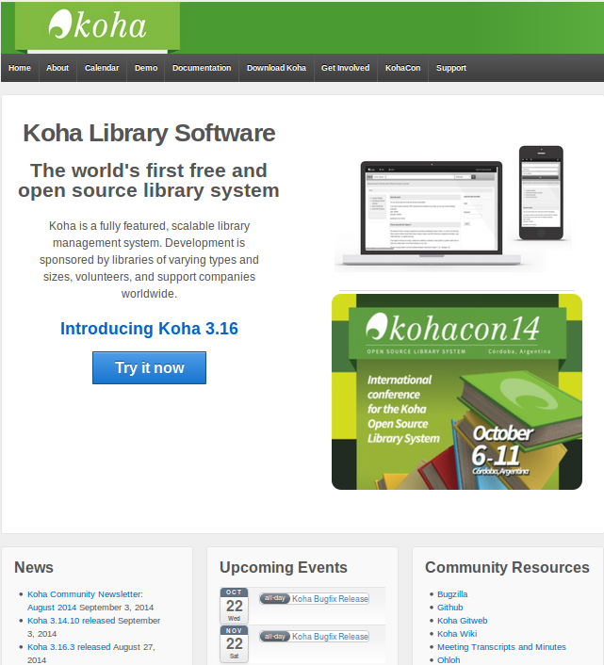
koha-community.org

Slide 11
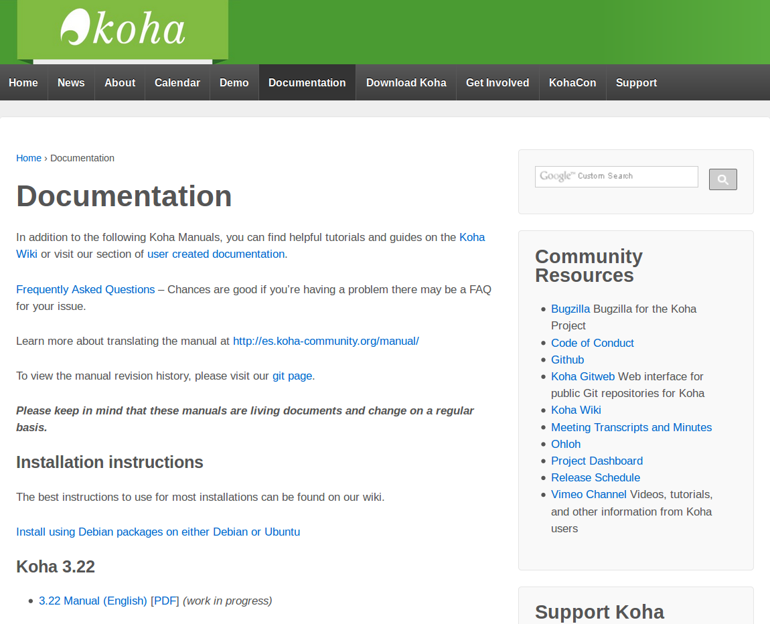
Documentation

Slide 12
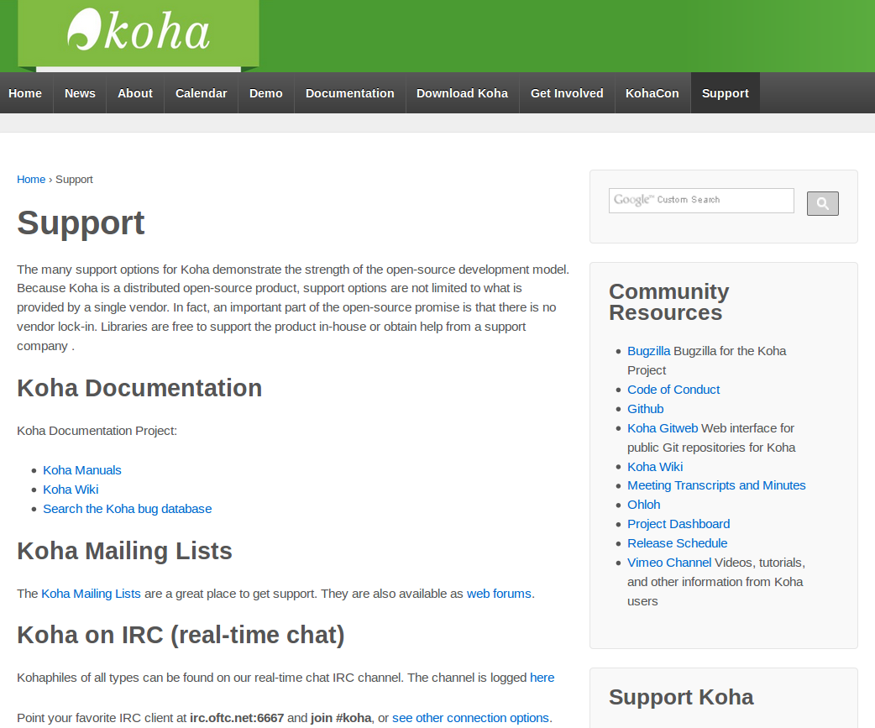
Community support

Slide 13
Koha conferences
This year Kohacon was at Aristotle University of Thessaloniki Library, Greece: 30 May – June 4.
Aristotle University is the largest academic institution in Greece, with a library of 1 million bibliographic records and 50,000 users.

Slide 14
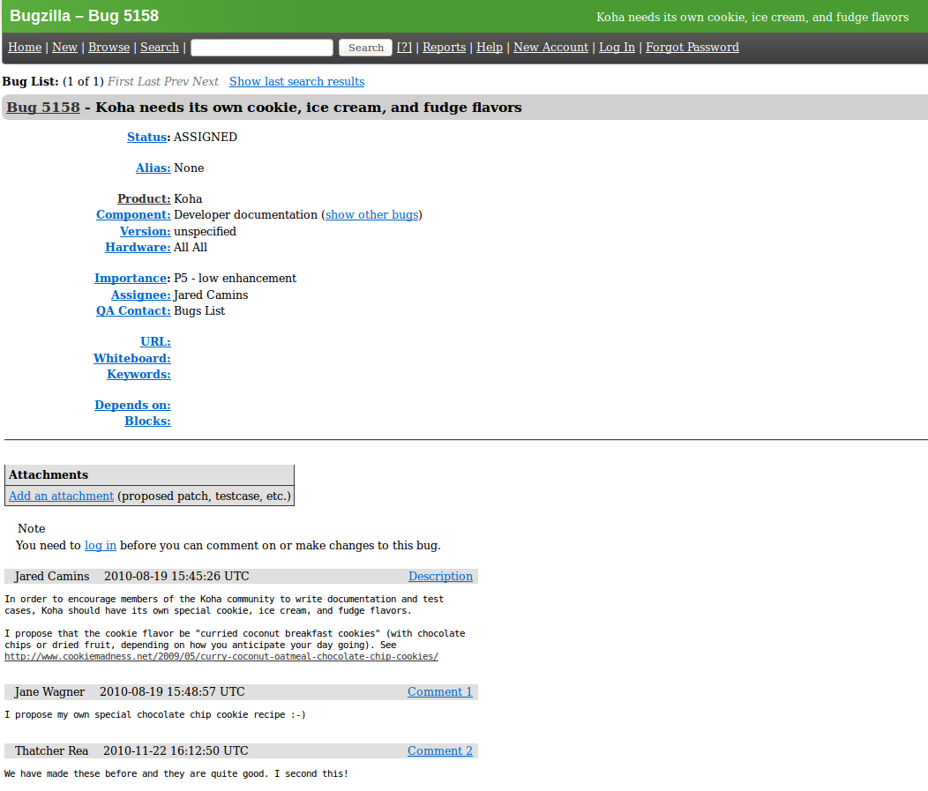
New feature and bug tracking

Slide 15
Koha:
Integration and extension examples

Slide 16
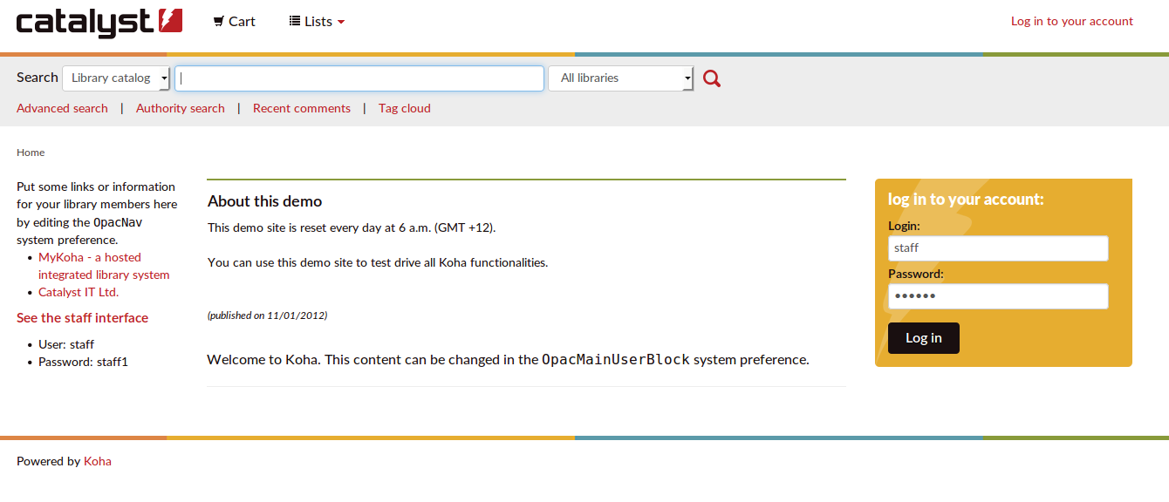
OPAC / Public interface

Slide 17
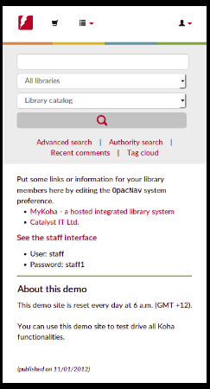

Slide 18
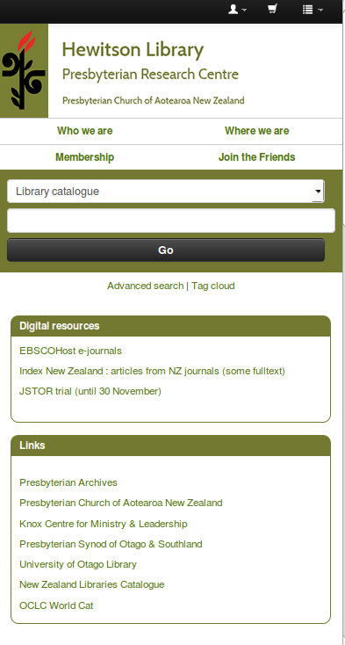

Slide 19
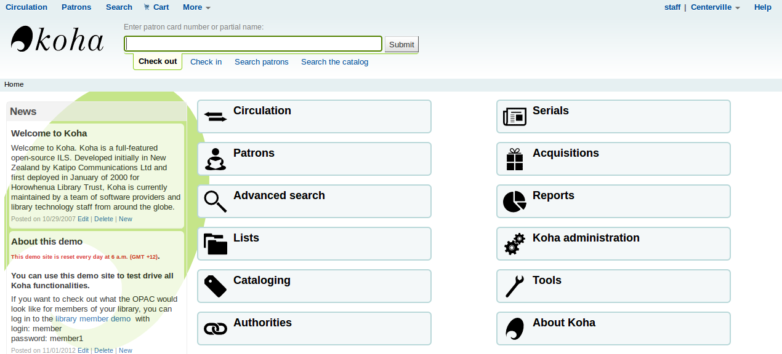
Staff interface

Slide 20
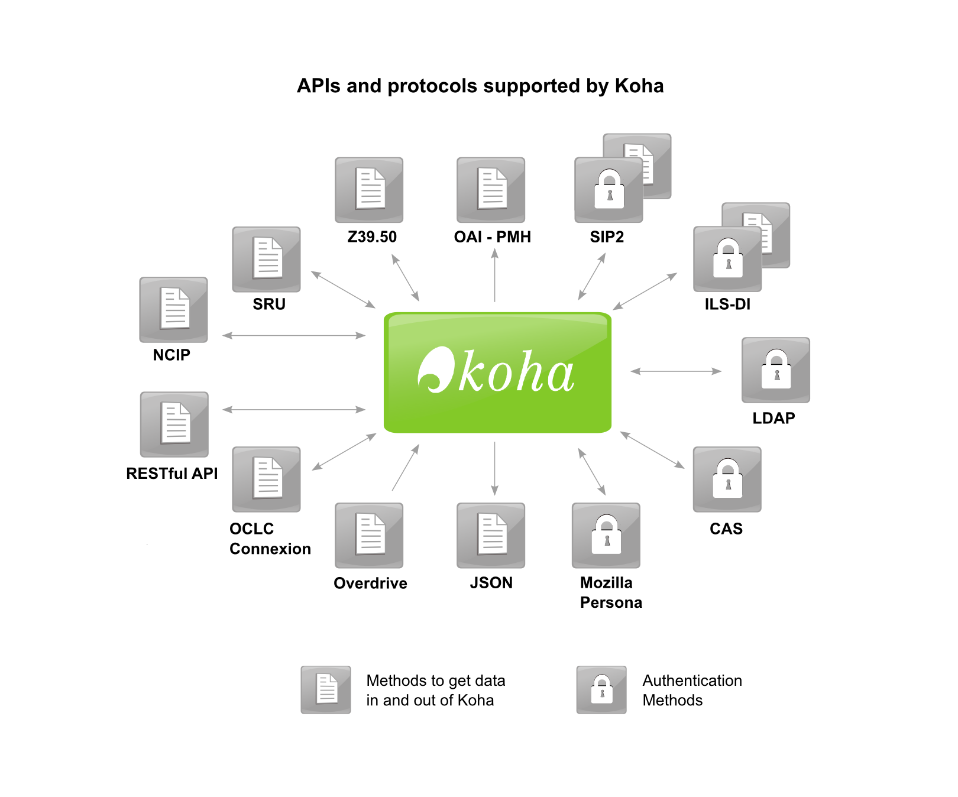
Open integration (it's a platform)

Slide 21
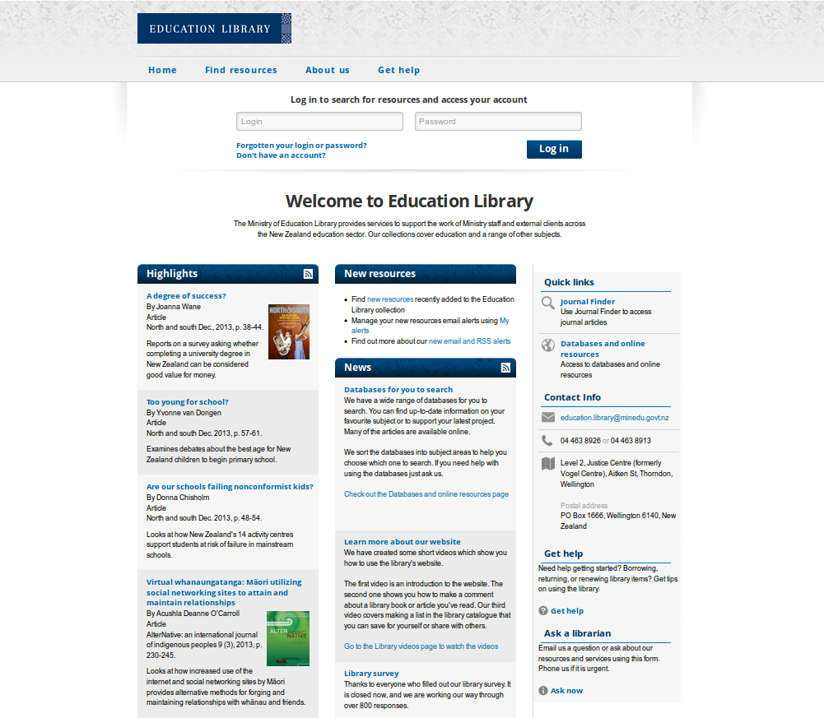
Integration e.g. with a Drupal website

Slide 22
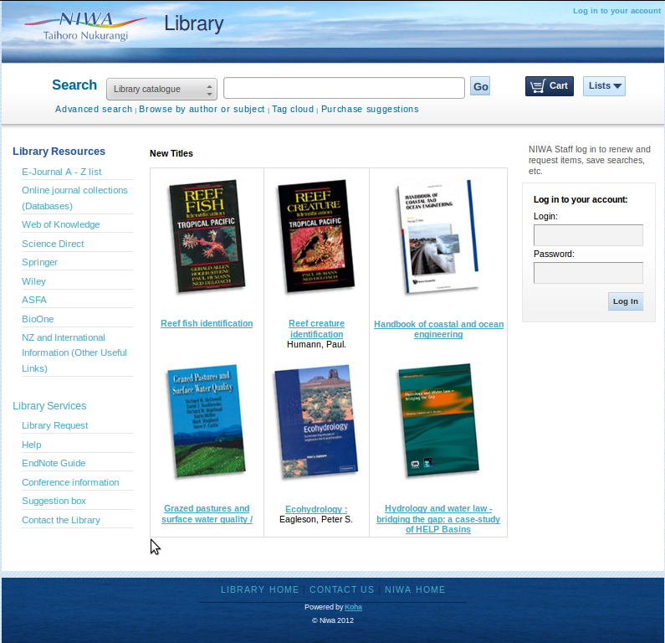
Koha as discovery layer

Slide 23
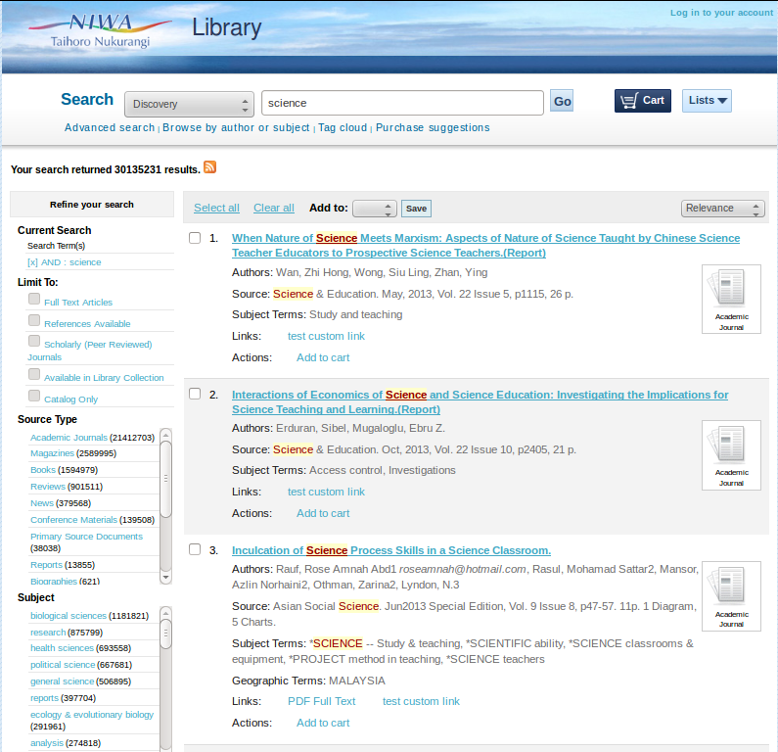
Koha as discovery layer - results

Slide 24
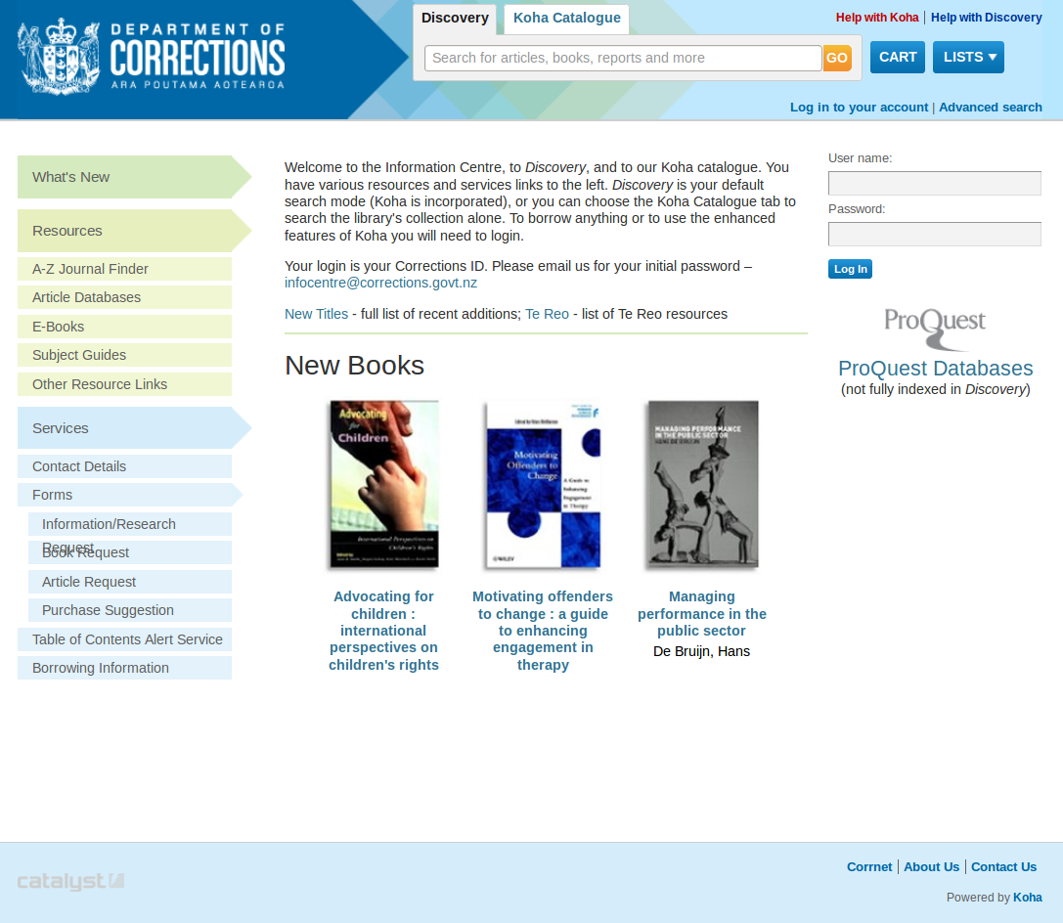
Koha as discovery layer

Slide 25
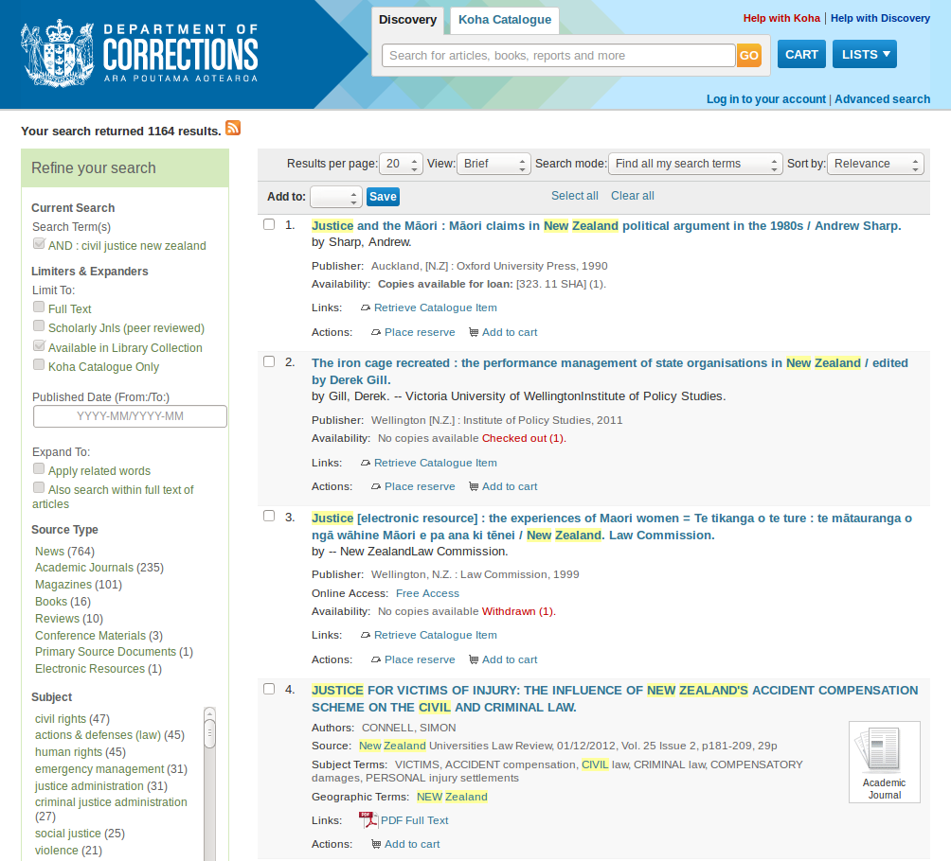
Koha as discovery layer – results

Slide 26
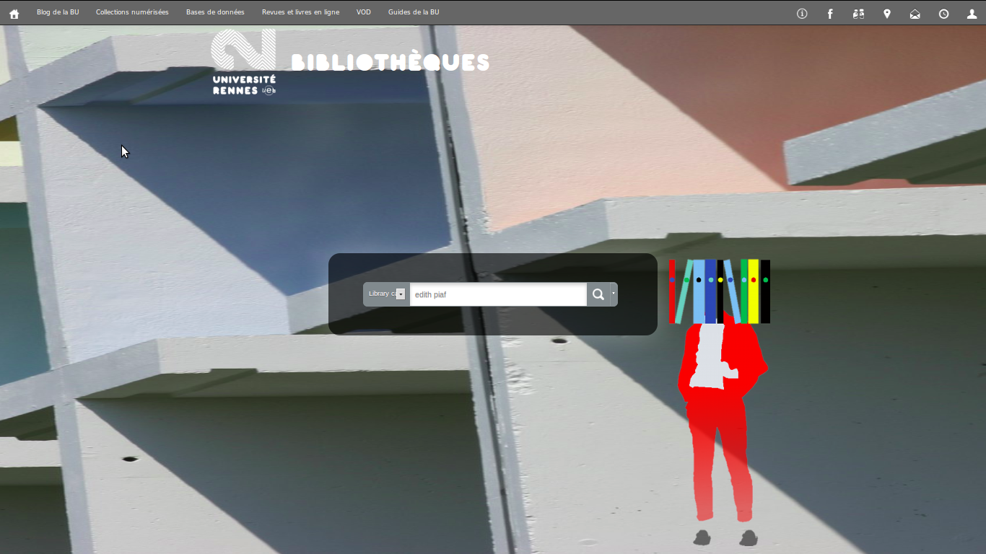
Koha as discovery layer

Slide 27
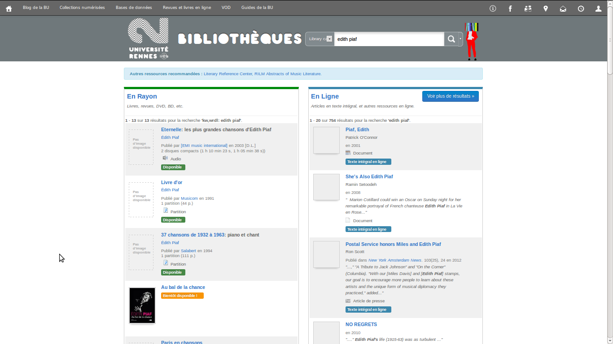
Koha as discovery layer - results

Slide 28
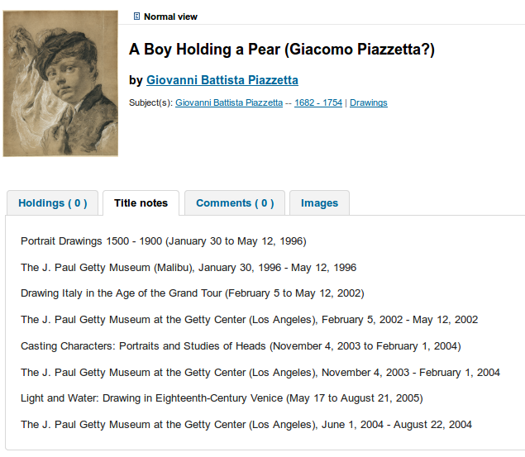
Pull in data from other sources

Slide 29
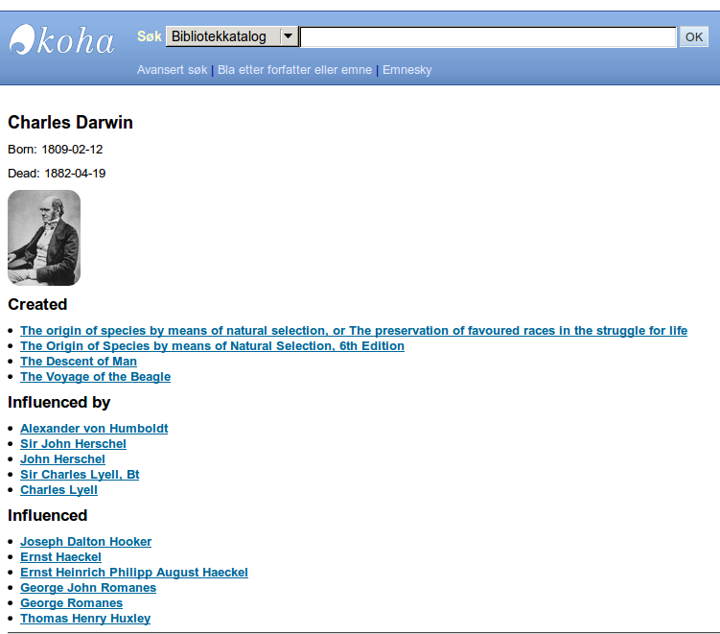
Linked data (preparing for Bibframe, RDF)

Slide 30
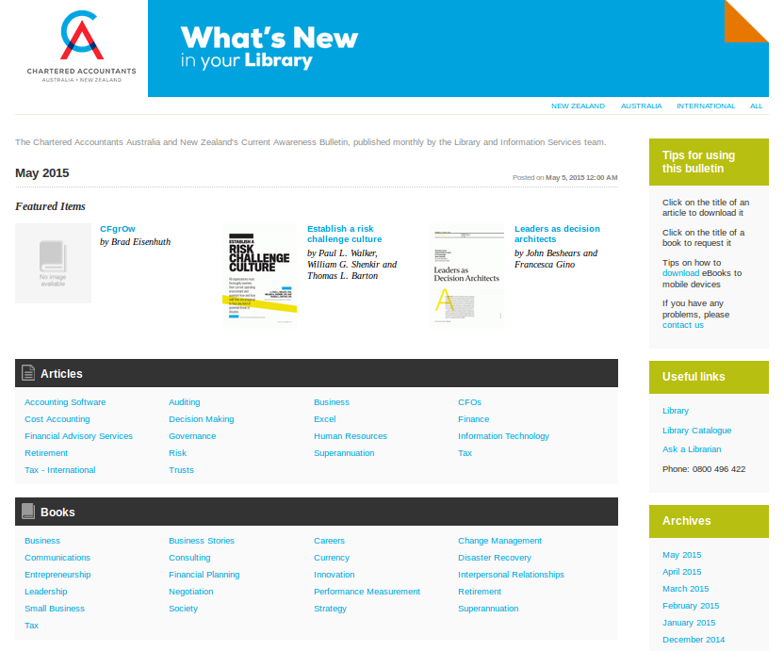
Display your data in other useful ways

Slide 31
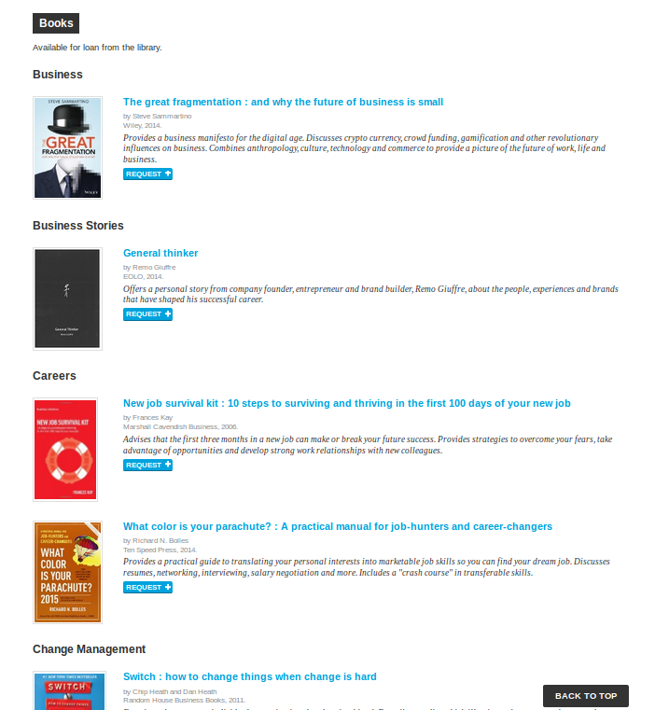

Slide 32
Elastic Search
A new, flexible Search Engine for Koha
Coming to Koha in 2016!
Full-text searching and data analsysis = better search results and intelligence about your collection
Can search across Koha + anything else (e.g. document respository)

Slide 33
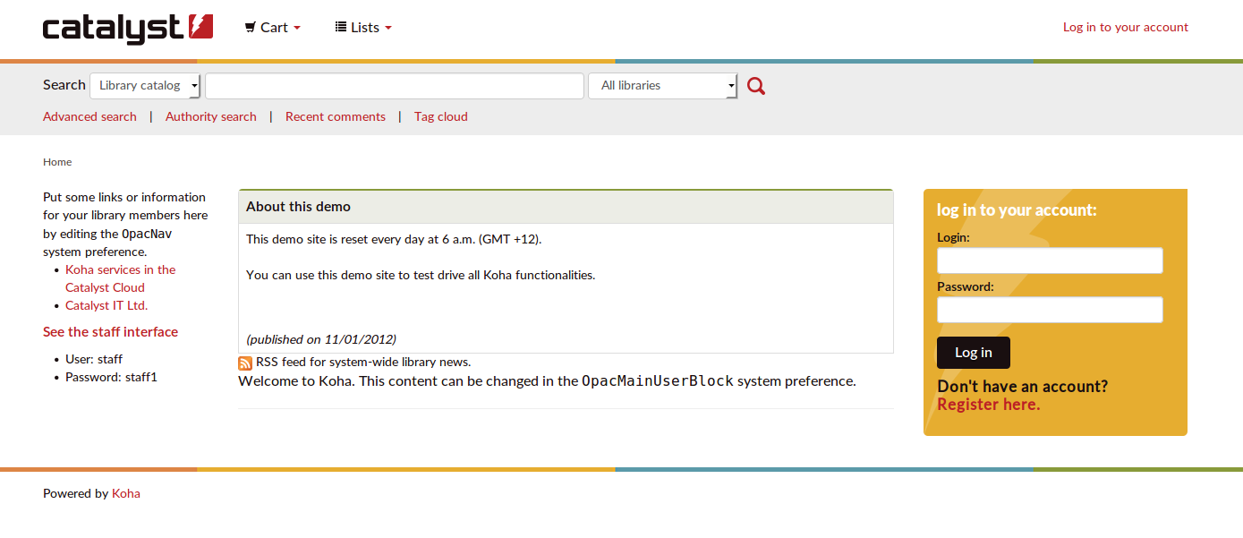
demo.mykoha.co.nz

Slide 34
Questions?

Slide 35
Koha Implementation project
Takes around 3 months, plus time for integration and development if desired
Remote and on-site support provided by Catalyst throughout.

Slide 36
Overview of Koha implementation project
Agree requirements: design, development, integration, hosted by Catalyst or the Library
Data Migration
Initial training
Refinements and data clean up
Development and integration
Design
Pre go-live training
Go-live
Post go-live refinements
Ongoing maintenance and support

Slide 37
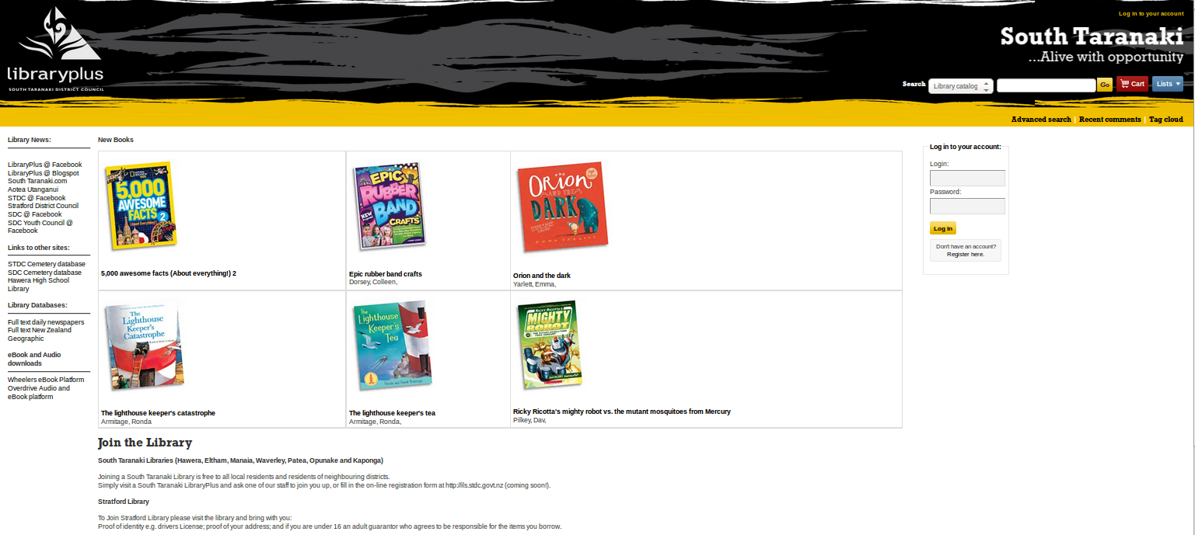

Slide 38


